Slide 1
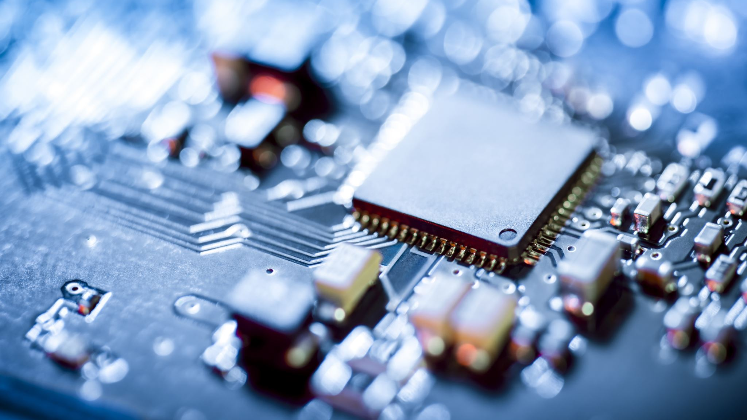
Custom NFC Antenna PCB & Data Transfer
Joaquin Sabin, Dylan Robens, Austin Weber, Alex Schroeder
Notes:
Dylan

Slide 2
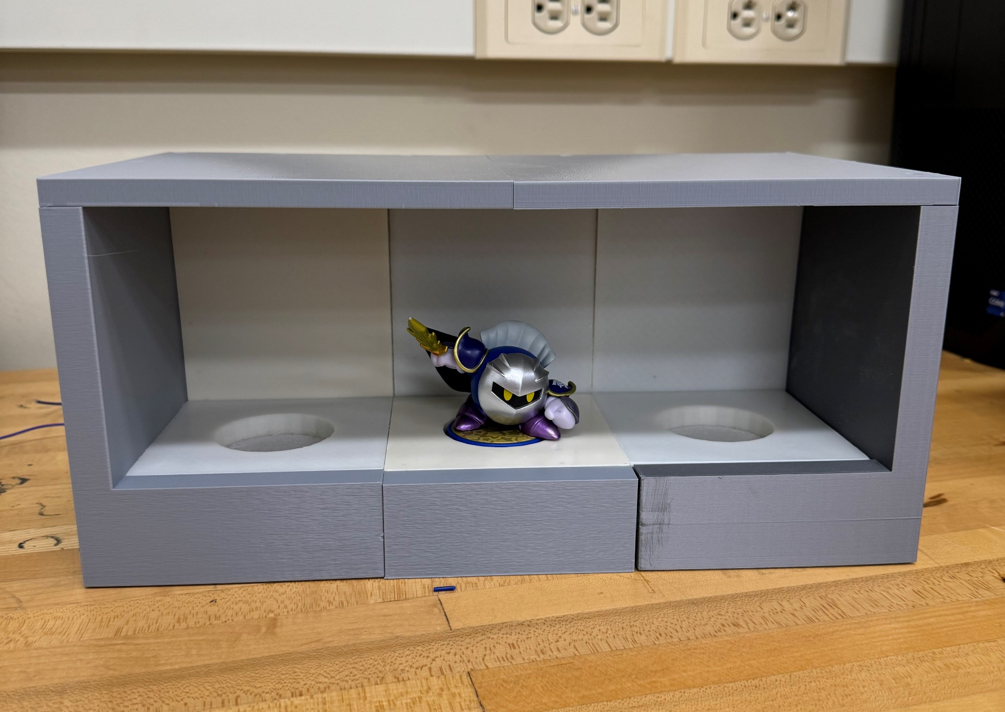
Introduction
NFC Technology and difficulties in using it
The group was interested in creating a display shelf
The group didn’t have much experience in custom PCBs
We focused on amiibo figures as they had NFC chips, and an idea to make custom NFC antenna PCBs came from that
The antenna interacts with the NFC chip inside the figures and reads their unique ID
Created a custom PCB which controls and handles all data transfer
Notes:
Dylan
Our group was really interested in the idea of wanting to create to create a display shelf as a project, and so we began to brainstorm ideas on how we could add NFC technology.
The group didn’t have much experience in creating custom PCB boards outside of class, and we wanted to learn more about the process of creating PCBs.
With these things in mind, we realized we could use amiibo as they have NFC chips in them with unique data that needs to be scanned via an NFC antenna and create a custom NFC Antenna.
NFC technology is a subset of RFID communication that is becoming more and more popular due to not needing an external powersource to communicate at the cost of a shorter range.
Most NFC data is rather confidential and could land us in legal trouble if we were to use it as a medium for this project hence why we are using amiibo.
This Antenna would need to be able to communicate and transfer data over a relatively sizeable distance of 5cm, as well as transfer the data accurately. (most NFC antenna’s range is around 3 cm)
So the concept for our project was made: we would focus on creating a custom NFC PCB which handles all data transfer over a distance and can accuratly transfer the read data over said distance.

Slide 3

Objectives of the project
Custom NFC board with 5cm range
Modular power
Showcase effective data communication through LED and eventually other means
Create a clean and effective product that shows off this communication
Communicates with amiibo figurines
Notes:
Joaquin
The goal of this project was to create a custom NFC antenna that can communicate effectively from a larger distance than normal NFC antennas do (targeting 5 cm of effective range) while ensuring that the data was accurately transferred over with no interference.
We also wanted to create a modular power sharing system, but due to the time constraints of receiving our PCBs much later than when we wanted, we ended up having to scrap this.
Currently we are showing effective data communication through Amiibo's and lighting up LEDs according to which Amiibo was scanned. With modularity we hope to showcase multiple boards communicating between each other and have more means of showcasing this data communication.

Slide 4
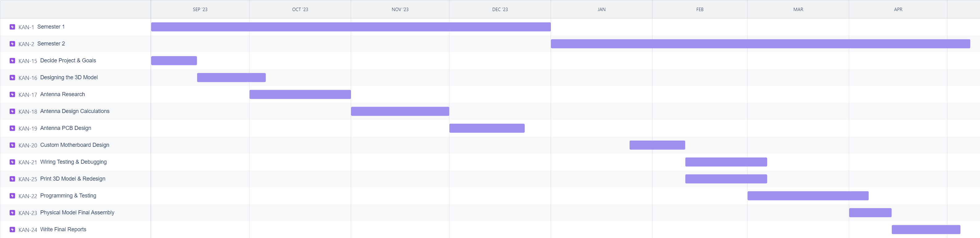
Timeline
Notes:
Austin

Slide 5
What We’ve Accomplished
Made calculations, designed, and fabricated an NFC antenna
Designed and fabricated a motherboard PCB to process all data
Designed and 3D printed a model that successfully houses the antennas, sensors, and NTAG chips while being compact
Programmed all data handling to communicate with amiibo figures
Notes:
Alex
We successfully performed calculations in order to design and create a custom NFC antenna as well as simulated the designed Custom NFC Antenna to confirm it is working.
We also designed and fabricated a custom motherboard PCB based of an Arduino Mega. We did this to cut down on costs in the project by removing parts we did not need. The design went well, but unfortunately when we received our custom PCB boards from JLCPCB, the microchips on them were rotated in the wrong orientation. After reviewing our files: we were able to determine that we declared their orientation correctly, and so this was a fault of JLCPCB on why these boards did not work.
We designed and printed a 3D Model that Successfully houses our custom Antenna, Sensors, and NTAG chips while remaining compact.
Made a custom program to read data off the amiibo figures.

Slide 6
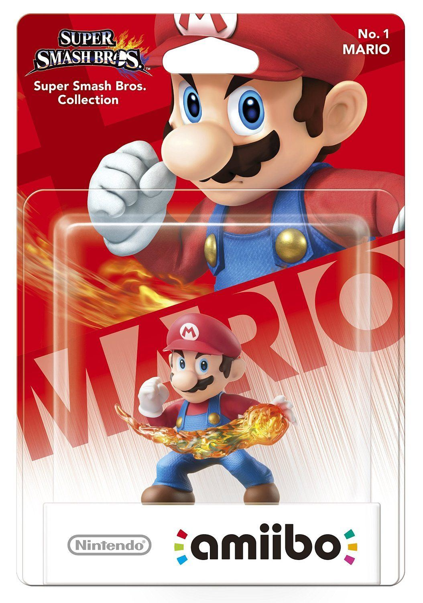
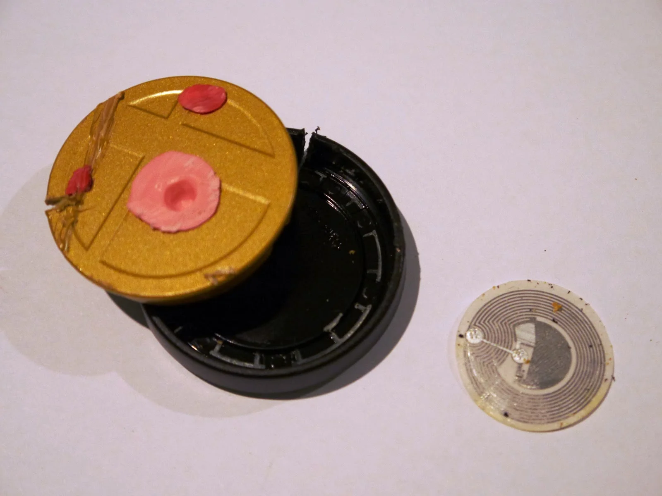
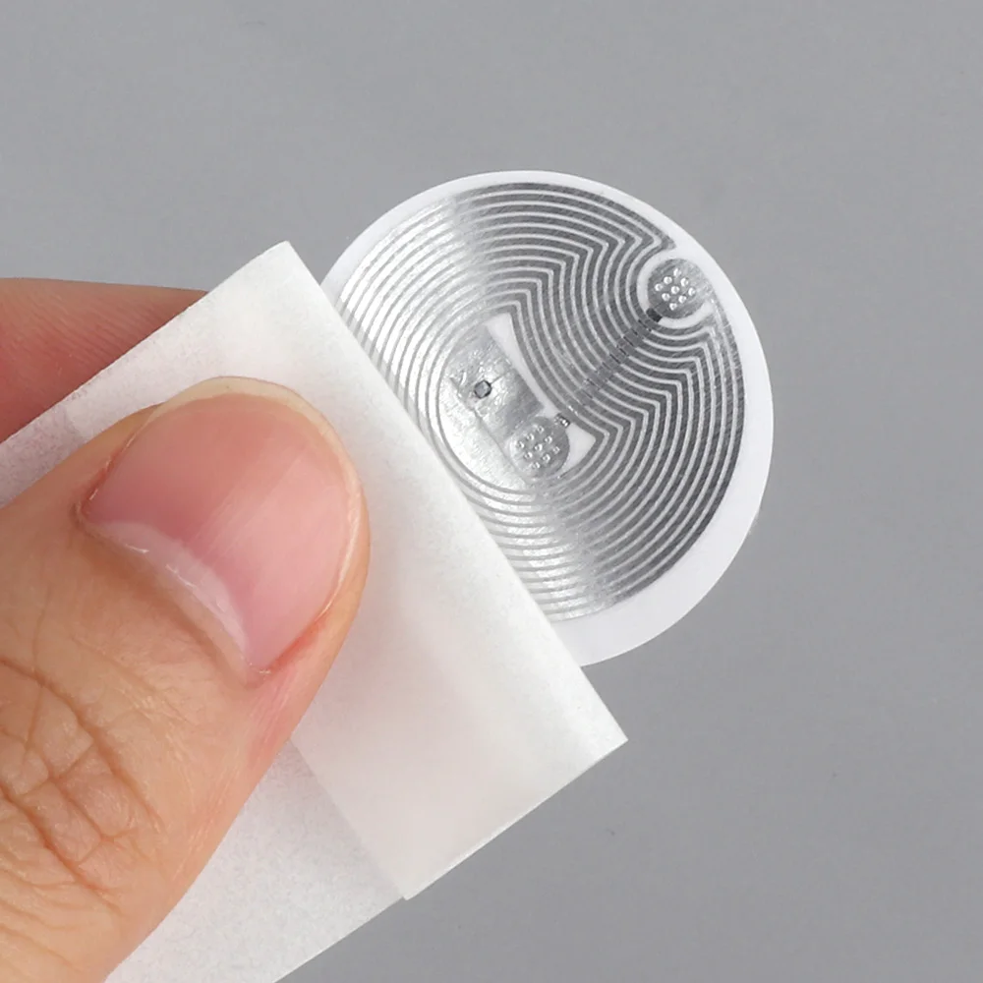
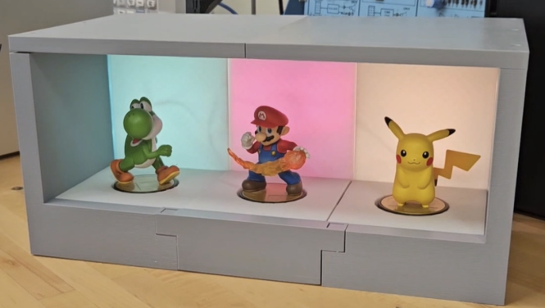
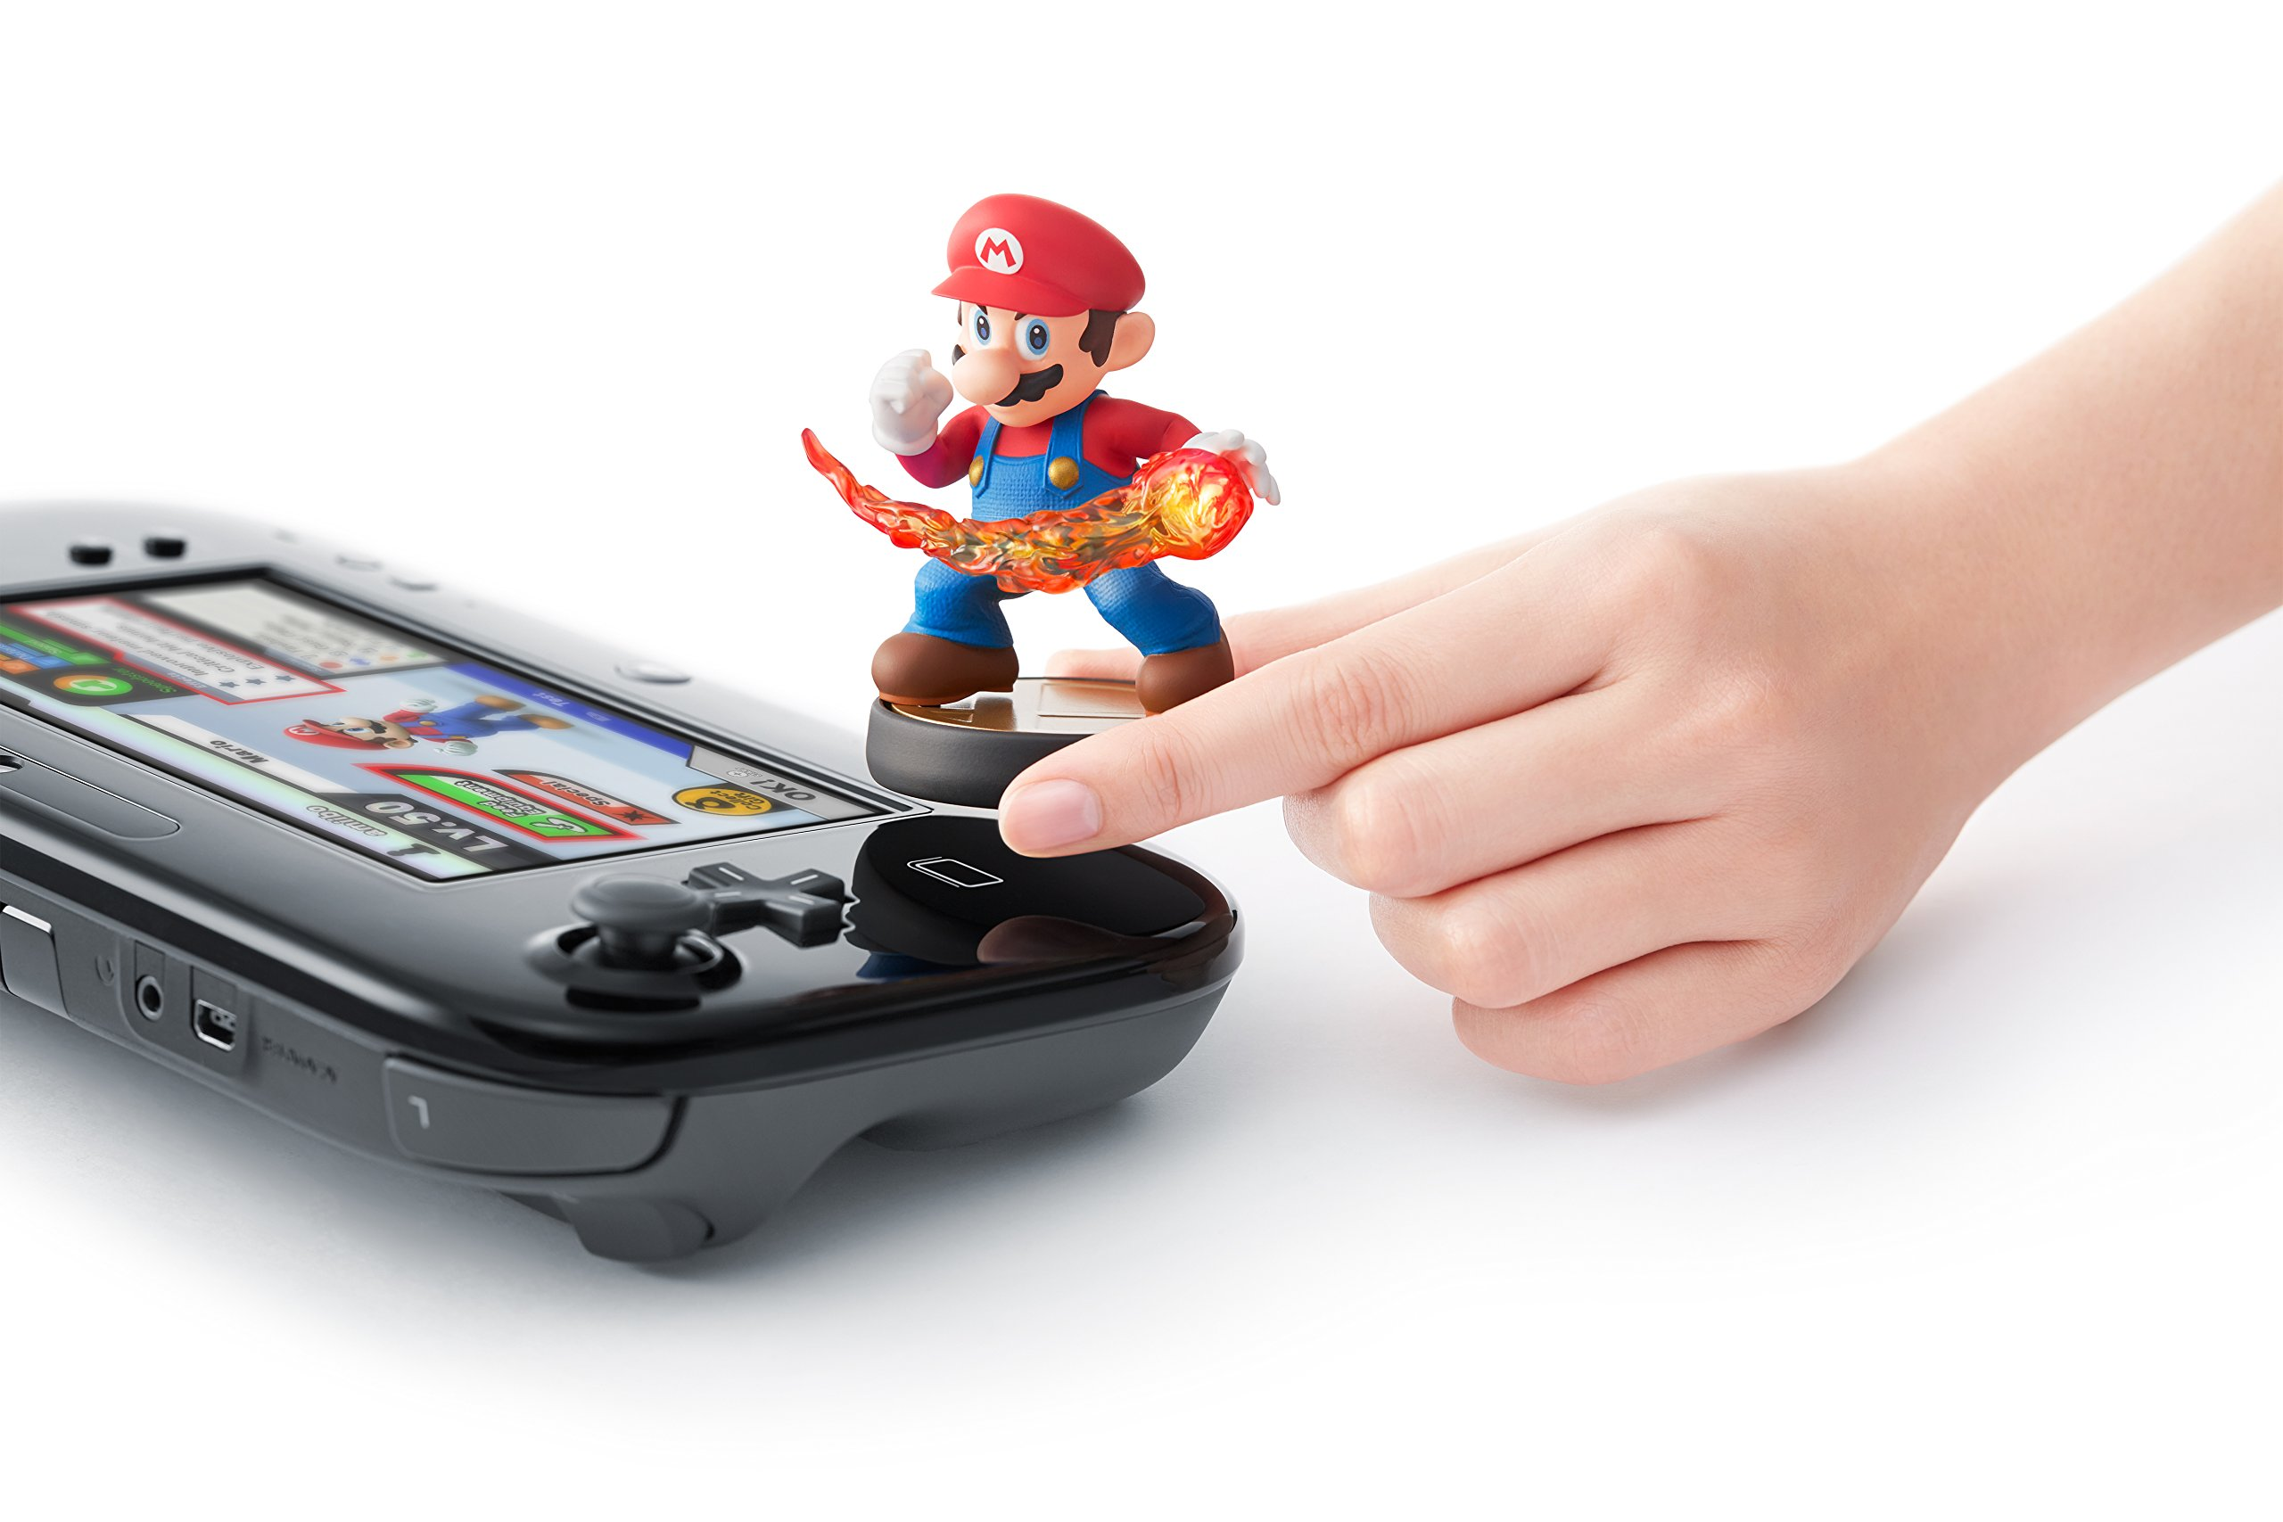
Amiibo Overview
Notes:
Austin
amiibo are figurines that include an NTAG215 chip, which allow interaction between the figurine and various Nintendo game systems through near field communication. These chips store static and dynamic data related to the character and games the figurine can interact with. Due to our familiarity with amiibo and documentation on their data, we felt that they would be the perfect item to use with our custom reader. Another reason we chose amiibo was because amiibo do not contain private data, such as that found on credit cards, IDs, and other security devices.

Slide 7
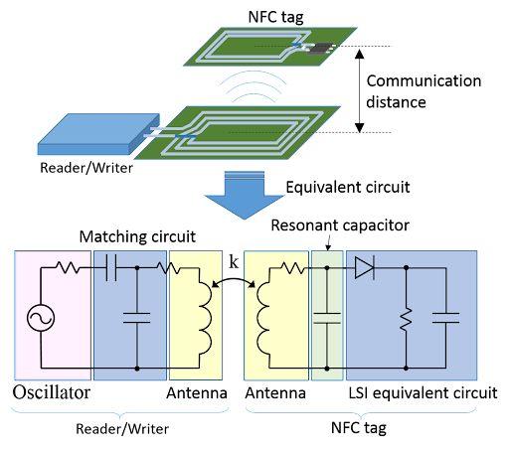
NFC Board Electromagnetics Overview
Notes:
Dylan
There are two main components to using NFC technology: an Antenna (shown above by the Reader/Writer) and the NTAG chip (Shown above by the NFC Tag)
The Antenna requires 3 main parts: The Antenna, the Matching Circuit, and the Oscillator.
The Oscillator sends out a periodic electronic signal which basically “Pings” the surrounding area in an attempt to try an read an NFC tag.
The Matching Circuit is used to transfer nearly all of the power in the circuit to the load of the circuit by using reactive components like capacitors (in this case, the Antenna is the load)
The Antenna in this case will then have nearly maximum power being transferred to it and generate a magnetic field. This magnetic field will induce a current in the antenna in the NTAG chip.
After a current is induced in the NTAG chip, the NTAG chip is powered and then begins to send its data back to the NFC Antenna.
The Antenna was optimized to run at 13.56 MHz of frequency, and we used smith charts to concluded that our matching circuit and antenna would not only reach the specified 5 cm distance, but would also ensure maximum power transfer to the load.

Slide 8
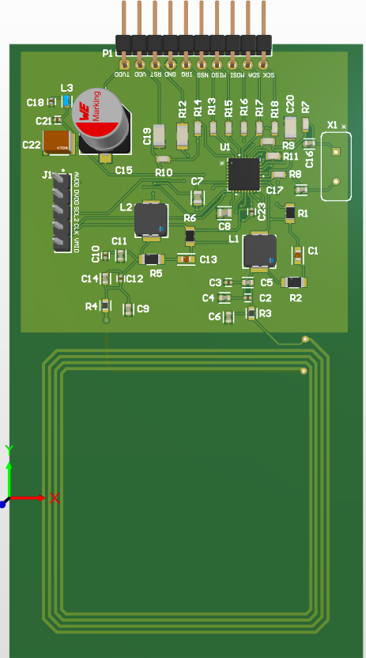
NFC Antenna
Culmination of Semester 1 work
Looked into how to achieve 5cm operating distance
Simulations showcase it working – Smith Chart
Notes:
Alex
Our first semester was used to create an effective NFC Antenna and calculating the needed specifications of the circuit for this board.
We eventually figured out the values that our components that would need to be used to effectively communicate at a distance of 5 cm.
According to simulations based off the NFC antenna circuit we created, we know our antenna mathematically works and should be optimal for our design
After having debugged the board, we were able to read the registers that exist on the chip.
We would need to purchase a development board from NXP in order to program these registers, which we do not have the budget for.

Slide 9
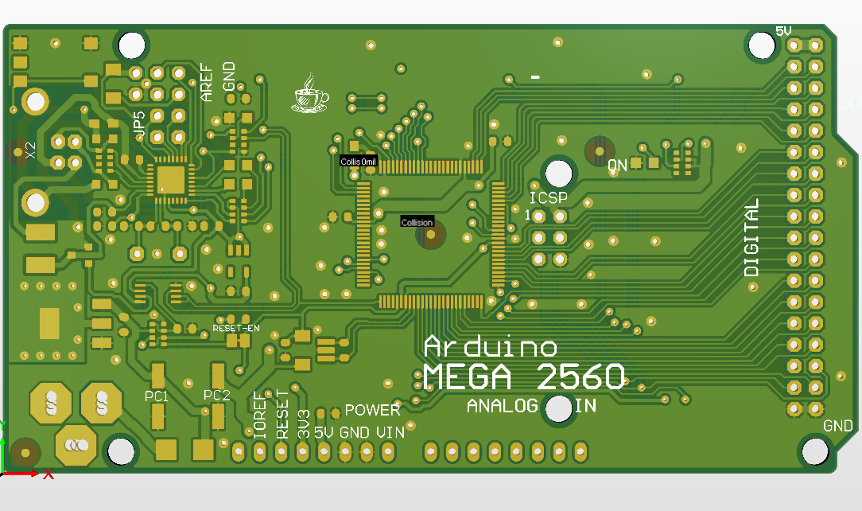
Custom Motherboard PCB
Handles all the data communication and process all functions of the shelf
Uses AT-Mega chip
JLCPCB fabricated it incorrectly making it unusable
Notes:
Alex
This custom Motherboard handles all data management with the antennas
Uses the AT-Mega Chip, selected due to it giving us extra digital and analog pins to use.
JLCPCB messed up the microchip placements of our boards…. None of them work, touch more on next slide.

Slide 10
Manufacturing Issues
Utilized pick and place to fabricate boards
Part availability constraints due to limited stock
Global sourcing of parts caused delays
Part naming conventions caused orientation issues on Arduino Boards
Notes:
Alex
Through the Stout selected PCB manufacturer, JLCPCB, we ordered a pick and place fabrication method for all of our PCBs. This was done due to the extremely small size of components as well as the board contacts that those components sit on.
Part availability through JLCPCB was very limited due to the stock that they carry on hand. This stock fluctuated every week and made planning out what parts we could rely on them for really hard.
Due to this, we had to globally source parts from other manufacturers which led to project delays that reduced the amount of time we had with the boards.
When ordering the custom Arduino Mega Boards, due to a naming convention on our end that we used to label components on the board, JLCPCB thought some of the IC’s were resistors instead
This led to these components being incorrectly flipped around on all the boards and due to time constraints and limited budget, we were unable to fix these boards or order new ones through JLCPCB

Slide 11
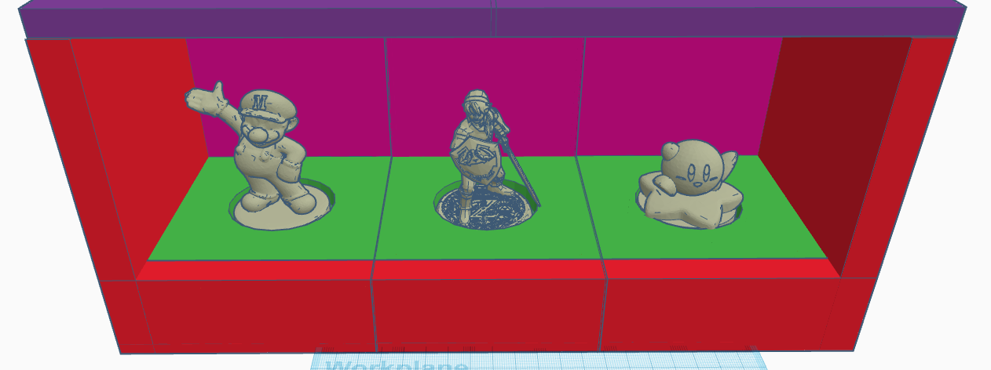
3D Model
Used CAD software to create a custom housing
Many redesigns for easy assembly and structural security
Design allows for easy access to internals when needed
Notes:
Dylan
Used CAD software to create a custom housing for the antenna to internally be held and effectively communicate with the amiibo.
Redesigned the shelf many times so that for easy assembly (<1 minute of assembly) and structural secure.
Allows for easy access of electronics by removing panels.

Slide 12
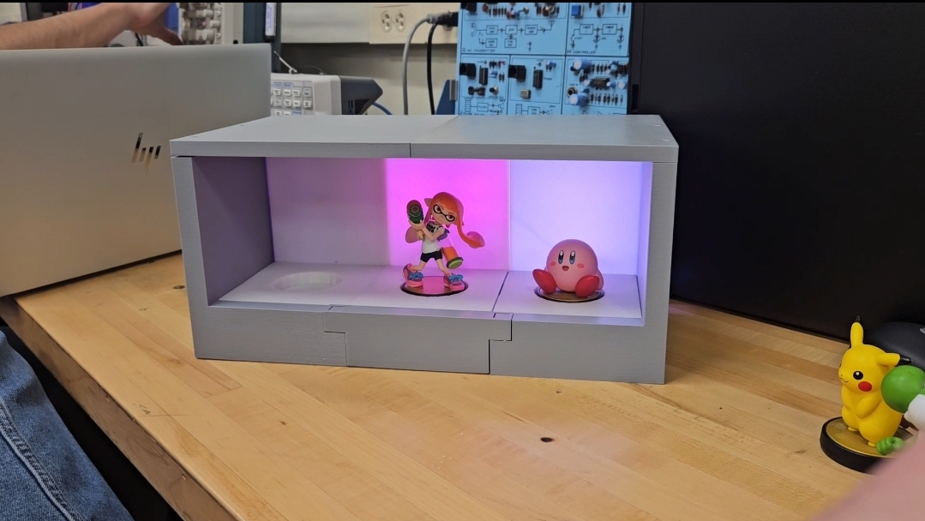
Full 3D Model
Notes:
Joaquin
This is the final design of our 3D printed case
The case fits together almost like tetris pieces, due to this it uses gravity to lock into place
The case features designated spots for all of our electrical circuitry to sit without sliding around inside
The case also has wire lanes to make wire routing easier and deliver a cleaner end product
In order to save budget costs, we decided to print only the areas that would be lit up in white PLA while all the structural pieces would be printed in grey.

Slide 13

Struggles we faced along the way
The NFC chip we used is very new
3D printer structural issues
JLCPCB delays messed up our timeline
JLCPCB globally sourcing parts
JLCPCB incorrectly placed components
Notes:
Joaquin
We struggled getting our custom NFC antennas debugged and working as it uses a new chip (CLRC663) and library with very little documentation that we were able to find. Old chip (MFRC522) had more but is not being produced anymore
Getting our initial 3D prints working was a challenge as certain overhangs led to a print failure
Due to JLCPCB we experienced a 2-month delay on both our boards arriving meaning we had very little time to debug and test the NFC Board
Ordering through JLCPCB was also a struggle as parts that we needed kept going out of stock and we needed to globally source nearly all our parts prior to the PCBs being made
JLCPCB also did not place our components correctly as we mentioned before which means the motherboards are completely unusable

Slide 14
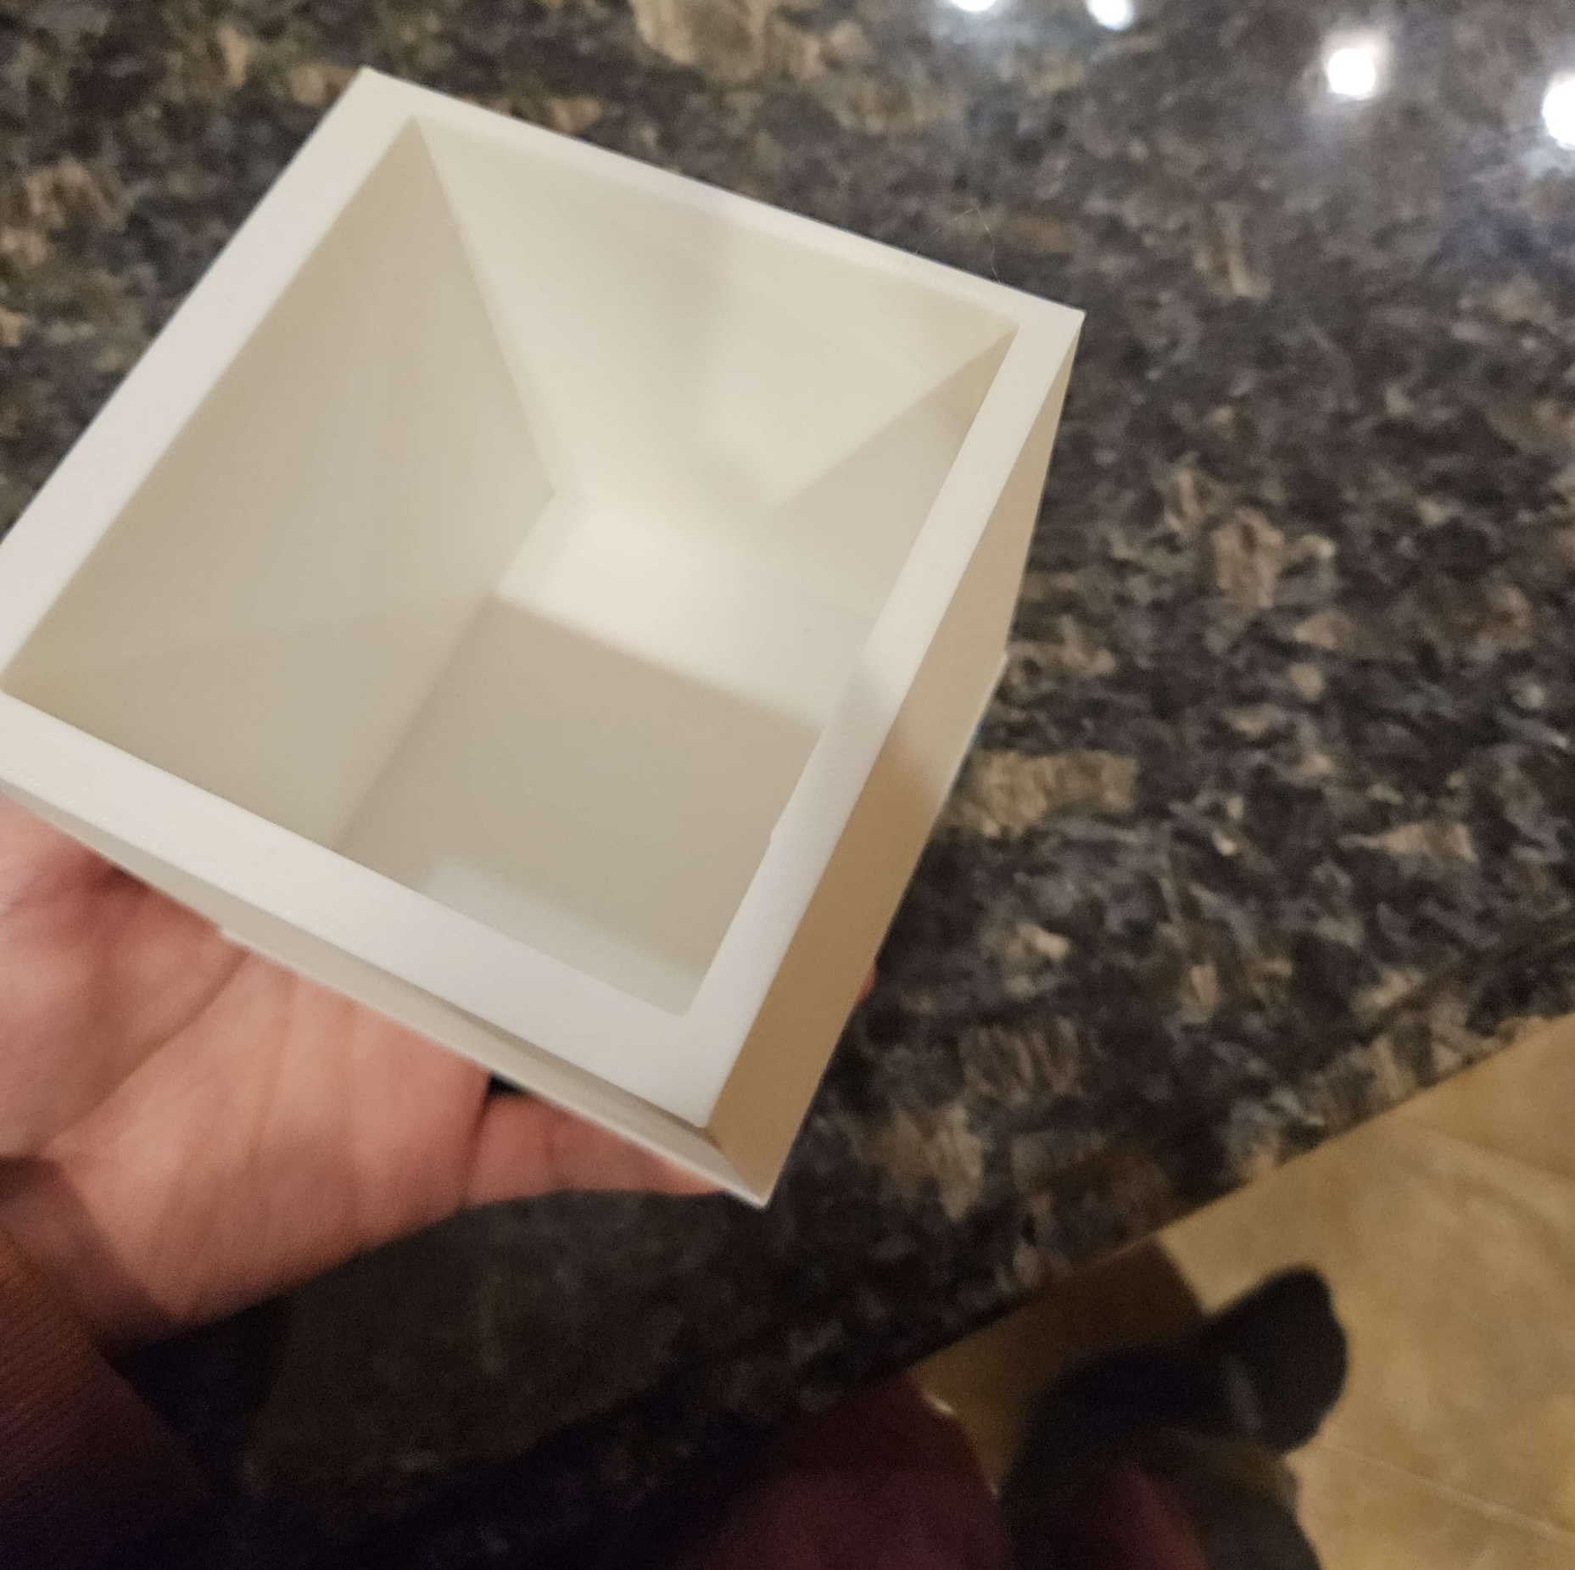
Tests/Debugging – LED placement
Preventing Blooming
Thickness testing of PLA
Infill testing
Notes:
Joaquin
We tested different thicknesses of the PLA that would allow light to pass through effectively
With the data that we gathered from that, we were able to implement different thicknesses of PLA to allow more or light into different areas
After we figured out the PLA thicknesses, we moved onto selecting the LED that would be primarily used in the end design
We ended up choosing a frosted digital LED in order to add additional diffusion to the case as a whole
We also tested different distances to place the LEDs within the case to ensure that the user couldn’t tell where the LEDs were

Slide 15
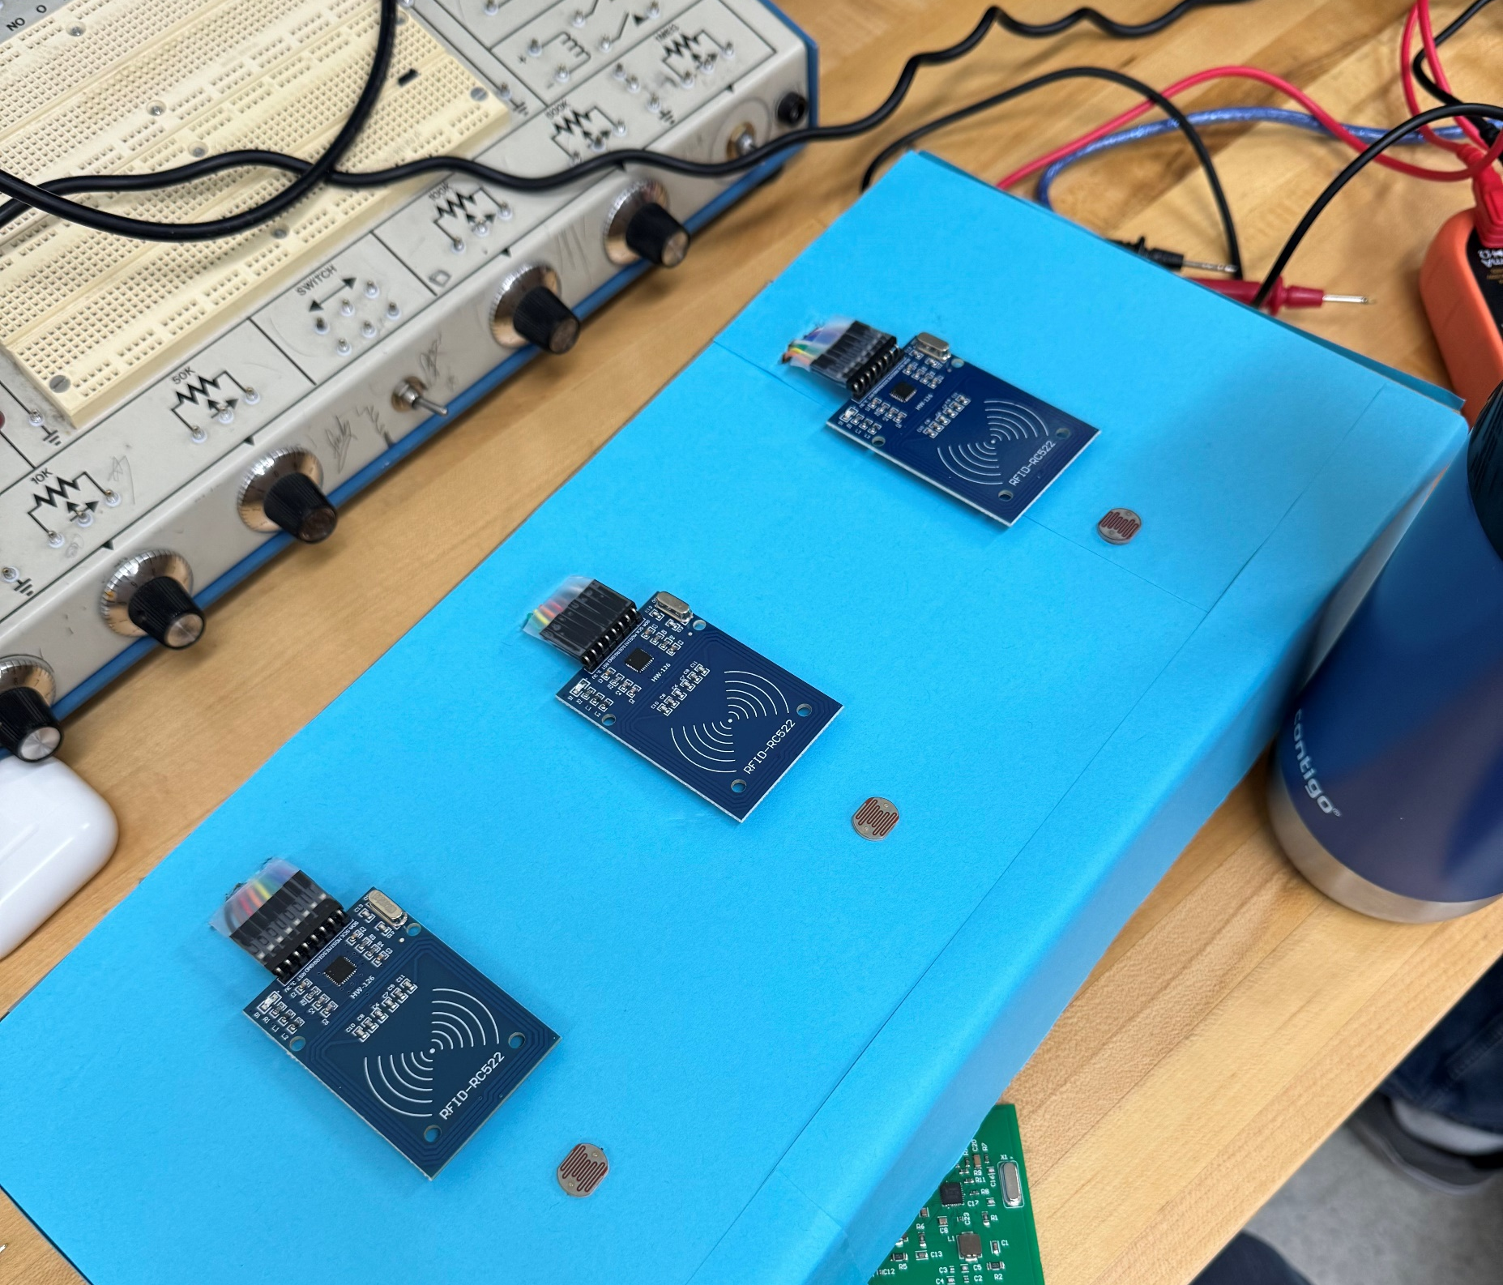
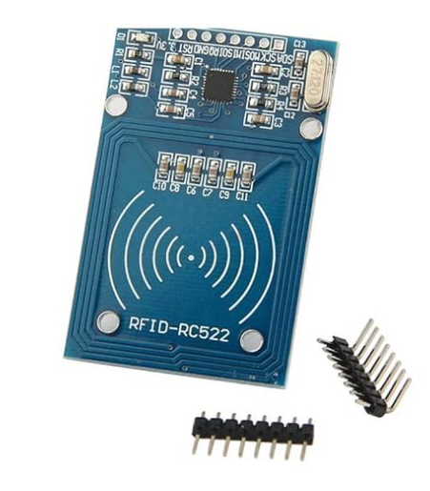
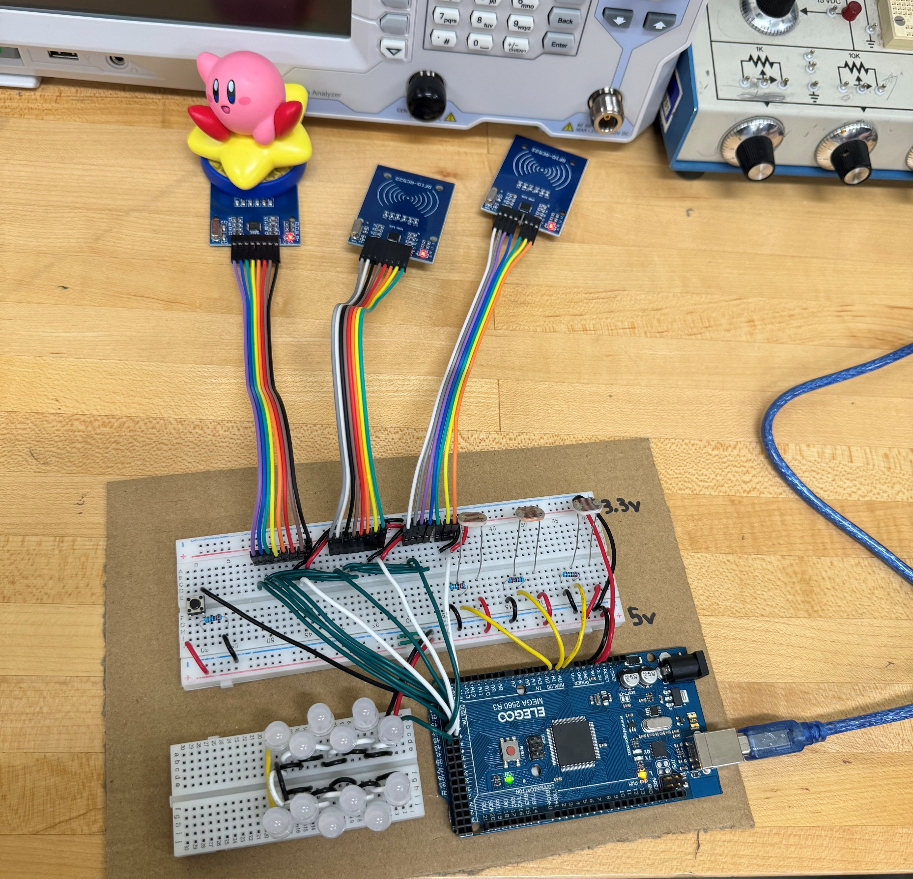
Tests/Debugging – Cardboard Prototype
Prototype
Testing code
Notes:
Joaquin
While waiting on our PCBs to arrive and 3D models to print, we created a prototype out of cardboard and amazon parts
This allowed us to begin coding and ensure the concept works with our carboard prototype
Set up photoresistors as a test to see if we could use them to detect if an amiibo were present.

Slide 16
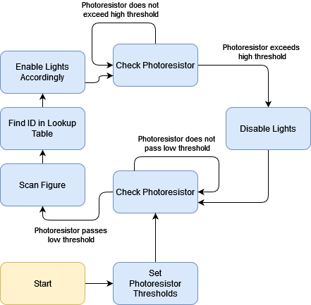
Programming
NFC Board
Photoresistors
COM-12877 LEDs
Notes:
Austin CLRC663 vs MFRC522
Reading the data (Pages 21 and 22)

Slide 17
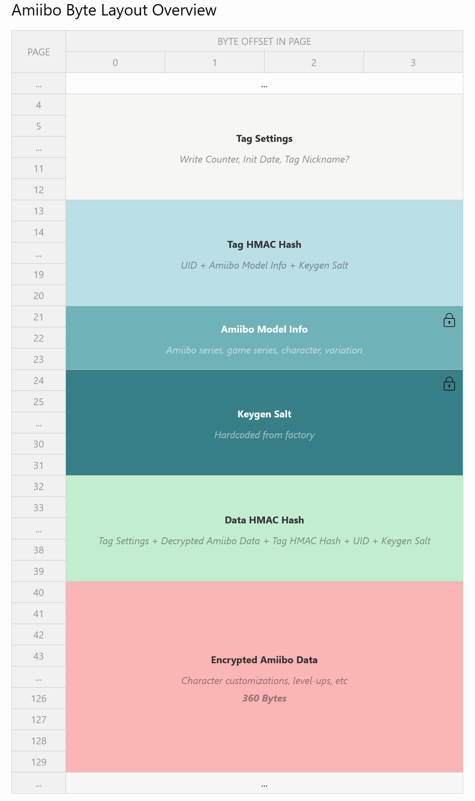
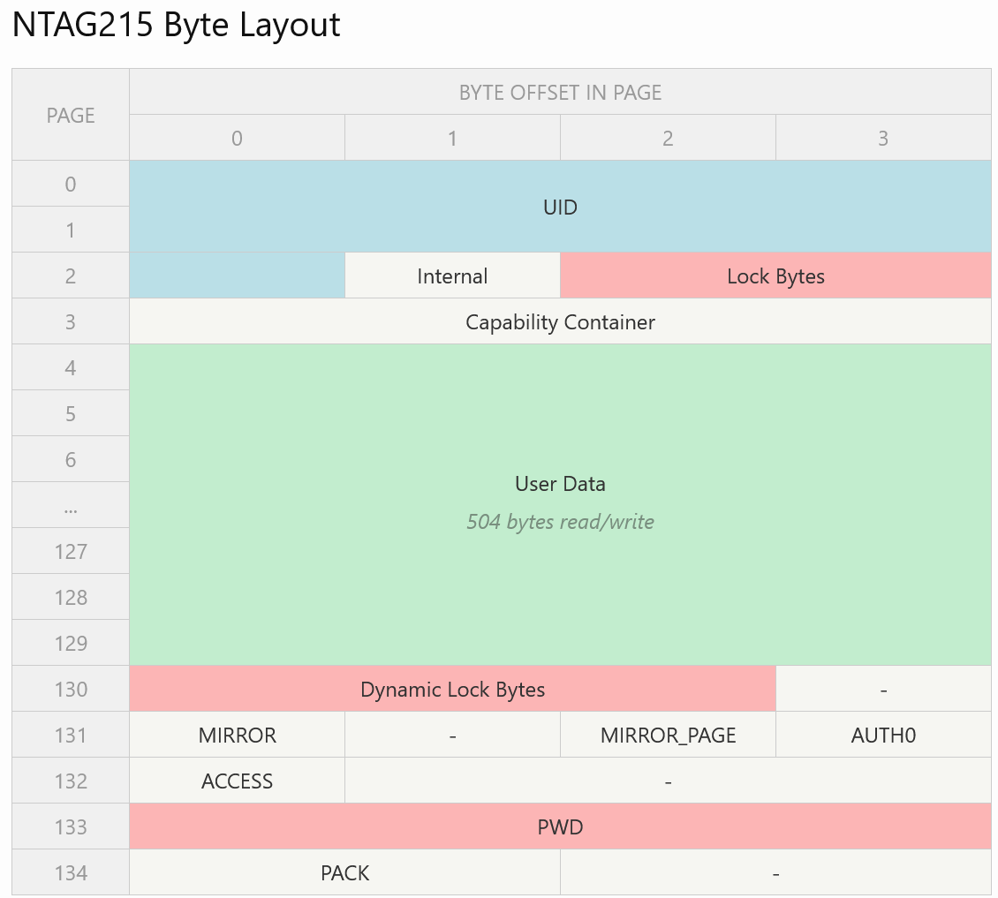
NTAG215 Data
Notes:
Austin
This is the internal layout of the NTAG215 chip, as well as the 504 bytes specific to the amiibo. Within each NTAG215 is 504 bytes of user data, which is split up specifically for the amiibo. Pages 21 through 31 are locked, meaning that they are unable to be edited. Pages 40 through 129 are encrypted with a proprietary key, which is copywritten by Nintendo and cannot be used. Our project specifically is interested in pages 21 and 22, which store what character and model the amiibo is. This section is not encrypted, so we are able to access it without breaking copywrite laws.

Slide 18
Conclusion Statement
Based on our research and simulation results our antenna design will function correctly. However, due to time and budget constraints in our debugging process, we have been unable to fully verify this functionality. Despite these recent setbacks we are confident that given additional time and resources our team would be successful in creating the final product that we envisioned two semesters ago. Our team is very proud of the research, development, and testing that went into this project and led us to what we have today.
Notes:
Austin
* Based on our research and simulation results our antenna design will function correctly. However, due to time and budget constraints in our debugging process, we have been unable to fully verify this functionality. Despite these recent setbacks we are confident that given additional time and resources our team would be successful in creating the final product that we envisioned two semesters ago. Our team is very proud of the research, development, and testing that went into this project and led us to what we have today.

Slide 19
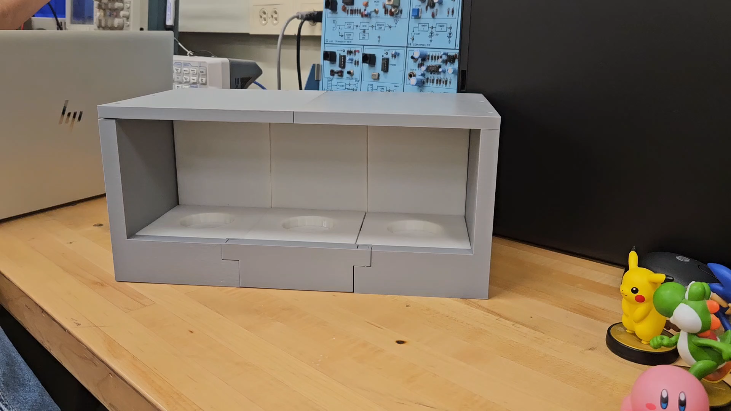
Working Prototype Demonstration
Notes:
Dylan

Slide 20
Physical Demonstration
Notes:
Austin

Slide 21

Questions?
Notes:
Alex

